Slide 1
Building a global approach: WHO global repository for epidemiological surveillance of drug safety in pregnancy and in general population
Christine Halleux, MD, PhD
Special Programme for Research and Training in Tropical Diseases
World Health Organization, Geneva
22nd International AIDS Conference
27 July 2018

Slide 2
Conflict of interest disclosure
I have no real or perceived, direct or indirect, conflict of interest in relation to this presentation

Slide 3
Concept
Available safety information on new ARV limited
Number of patients treated per country limited → limited capacity to detect less frequent ADR
Pooling of data from different countries together increase likelihood to detect any safety signal
WHO central database as a tool to facilitate the pooling of data collected at country level
Collect individual de-identified patient data
Collaborative work

Slide 4
Operation of WHO CENTRAL REGISTRies
IPD
IPD
Central Registry
IPD
IPD
WHO
IPD
ANALYSIS

Slide 5
Data analysis
Regular data analysis by WHO once sufficient data
Focus on safety signal detection, including identification of unknown adverse drug reactions
Results to be shared / discussed with contributing collaborators
Data generated as scientific evidence (e.g. WHO sub-committee on safety of dolutegravir, WHO treatment guidelines)

Slide 6
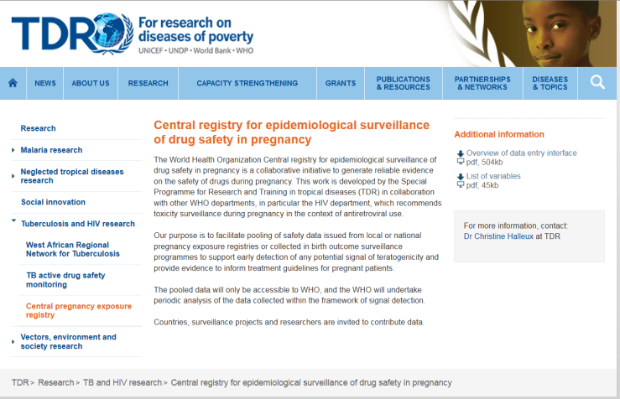
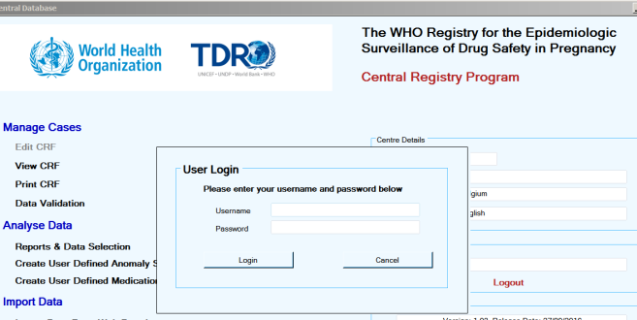
Central pregnancy EXPOSURE registry
List of key variables – Dictionary
Data entry programme
Central database – secure portal for data transfer

Slide 7
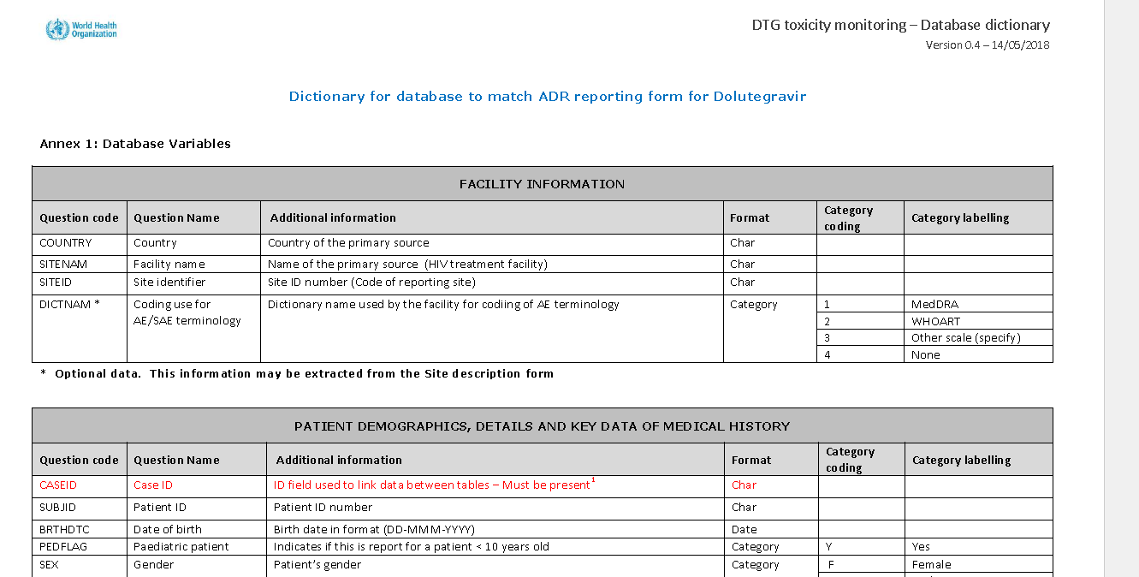
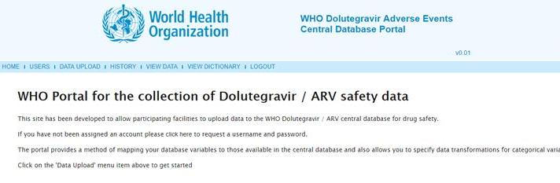
Central DTG / ARV safety registry
List of key variables – Dictionary
Central database – secure portal for data transfer

Slide 8
Next steps
Strengthen collaboration and networking with countries
Botswana, Brazil, Malawi, South Africa, and other countries where active toxicity monitoring is / may be implemented
Accumulate data… and analysis to generate evidence needed
For more information, contact:
C. Halleux at TDR: halleuxc@who.int
F. Renaud at HIV : renaudf@who.int
M. Vitoria at HIV: vitoriam@who.int

